Slide 1



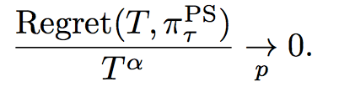
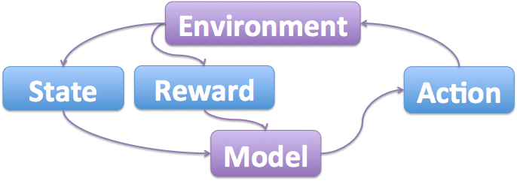
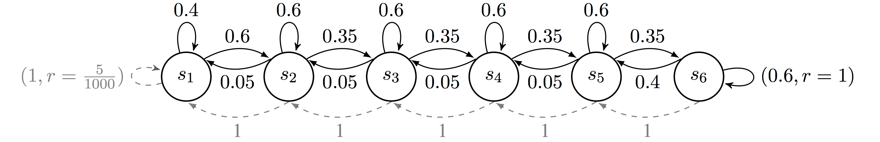
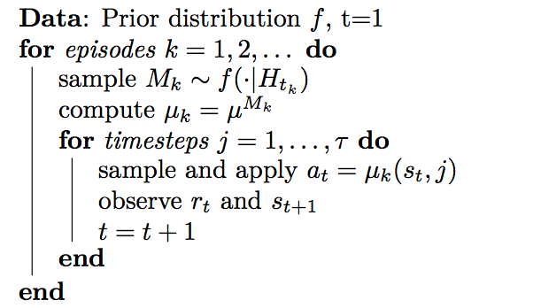
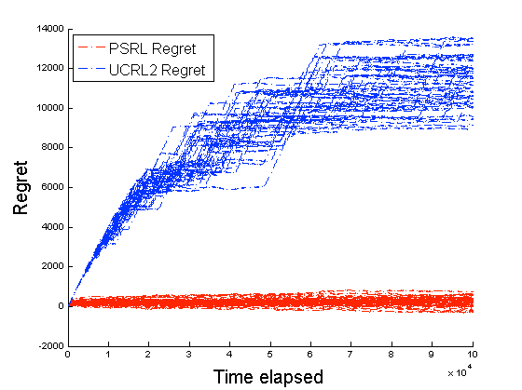
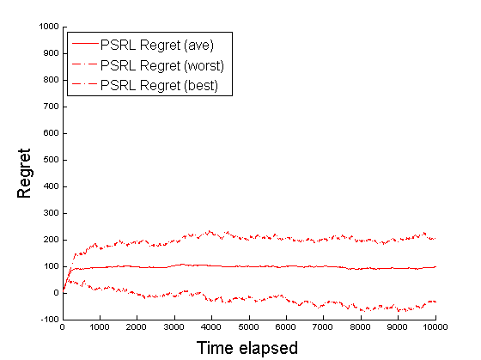
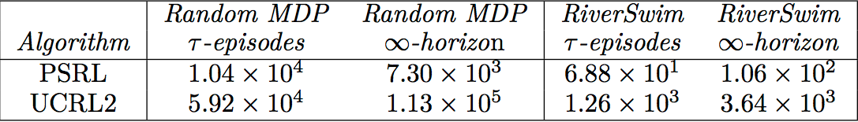
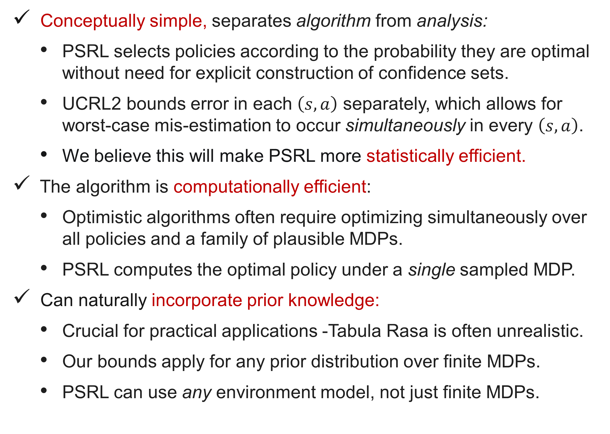
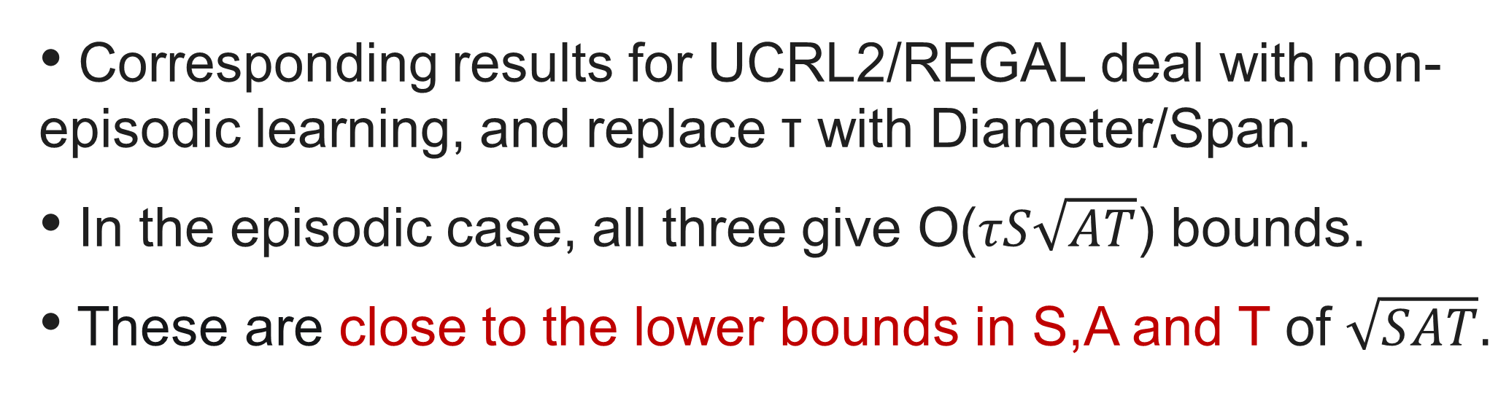
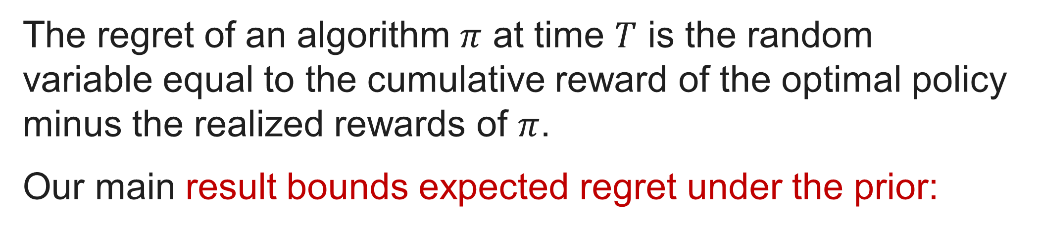
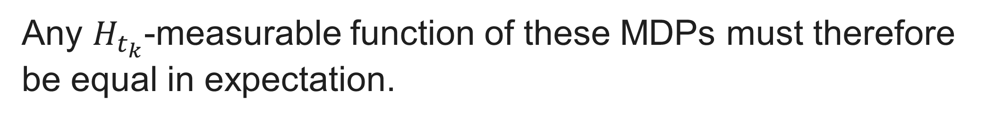
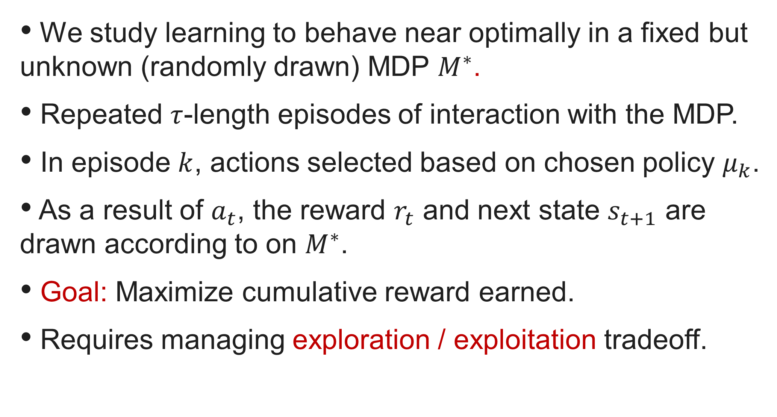
(More) Efficient Reinforcement Learning via Posterior Sampling
Ian Osband, Daniel Russo and Benjamin Van Roy - Stanford University
Introduction
Motivation - Advantages of PSRL
Key lemma - posterior sampling
We study efficient exploration in reinforcement learning.
Most provably-efficient learning algorithms introduce optimism about poorly understood states and actions.
Motivated by potential advantages relative to optimistic algorithms, we study an alternative approach: posterior sampling for reinforcement learning (PSRL).
This is the extension of the Thompson sampling algorithm for multi-armed bandit problems to reinforcement learning.
We establish the first regret bounds for this algorithm.
Conceptually simple, separates algorithm from analysis:
PSRL selects policies according to the probability they are optimal without need for explicit construction of confidence sets.
UCRL2 bounds error in each $\left(s,a\right)$ separately, which allows for worst-case mis-estimation to occur simultaneously in every $\left(s,a\right)$.
We believe this will make PSRL more statistically efficient.
The algorithm is computationally efficient:
Optimistic algorithms often require optimizing simultaneously over all policies and a family of plausible MDPs.
PSRL computes the optimal policy under a single sampled MDP.
Can naturally incorporate prior knowledge:
Crucial for practical applications -Tabula Rasa is often unrealistic.
Our bounds apply for any prior distribution over finite MDPs.
PSRL can use any environment model, not just finite MDPs.
The true and sampled MDPs are equal in distribution at the start of an episode (when the sample is taken).
Any $H_{t_{k}}$-measurable function of these MDPs must therefore be equal in expectation.
Regret bounds
The regret of an algorithm $π$ at time $T$ is the random variable equal to the cumulative reward of the optimal policy minus the realized rewards of $π$.
Our main result bounds expected regret under the prior:
Problem Formulation
We study learning to behave near optimally in a fixed but unknown (randomly drawn) MDP $M^{∗}$.
Repeated $τ$-length episodes of interaction with the MDP.
In episode $k$, actions selected based on chosen policy $μ_{k}$.
As a result of $a_{t}$, the reward $r_{t}$ and next state $s_{t+1}$ are drawn according to on $M^{∗}$.
Goal: Maximize cumulative reward earned.
Requires managing exploration / exploitation tradeoff.
This is not a worst-case MDP bound as per UCRL2 etc.
But, the two bounds are related via Markov’s inequality:
Experimental results
We compared the performance of PSRL to UCRL2 (an optimistic algorithm with similar regret bounds) on several MDP examples.
For any α > 0.5 :
Corresponding results for UCRL2/REGAL deal with non-episodic learning, and replace τ with Diameter/Span.
In the episodic case, all three give O($τS\sqrt{AT}$) bounds.
These are close to the lower bounds in S,A and T of $\sqrt{SAT}.$
We tested the algorithm on RiverSwim (an MDP designed to require efficient exploration) as well as random MDPs.
We saw that PSRL outperforms UCRL2 by large margins.
PSRL learns quickly even with a mis-specified prior.
Summary
Algorithm - PSRL
PSRL is not just a heuristic but is provably efficient
First regret bounds for an algorithm not driven by “OFU”.
Regret bounds are competitive with state of the art.
Bounds allow for an arbitrary prior over finite MDPs.
Conceptually simple, computationally efficient.
Statistically efficient, separating algorithm from analysis.
Performs well in simulation on benchmark MDPs.
References
Please consult arXiv:1306.0940 for a full list of references.
Simulation code is available at www.stanford.edu/~iosband
*First introduced by Strens (2002) under the name “Bayesian Dynamic Programming.”

